Slide 1
Direct Mapping
• Each block of main memory maps to only one cache line
• Address consists of two parts
– Least Significant w bits - identify unique word
– Most Significant s bits - specify one memory block
• Most Significant s bits are split into
– a cache line field r bits and
– a tag of s-r bits (most significant)

Slide 2
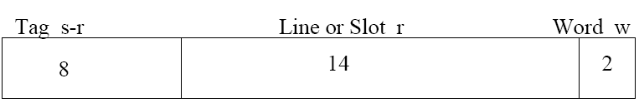
Direct Mapping - Address Structure
• 24 bit address
• 2 bit word identifier (4 byte block)
• 22 bit block identifier
– 8 bits tag (=22-14)
– 14 bits line
• No two blocks in the same line have the same Tag field
• Content of cache is checked by finding line and checking Tag

Slide 3
Direct Mapping Cache Line Table
Cache line Main Memory blocks held
0 0, m, 2m, 3m…2s-m
1 1,m+1, 2m+1…2s-m+1
m-1 m-1, 2m-1,3m-1…2s-1

Slide 4
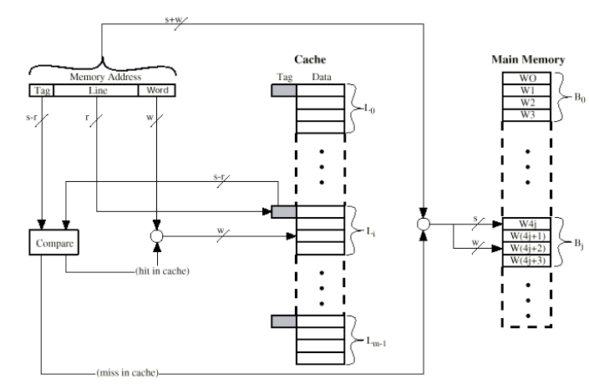
Direct Mapping Cache Organization

Slide 5
Direct Mapping Summary
Address length = (s + w) bits
• Number of addressable units = 2^{s+w} words or bytes
• Block size = line size = 2^{w} words or bytes
• Number of blocks in main memory = 2^{s+w} / 2^{w} = 2^{s}
• Number of lines in cache = m = 2^{r}
• Size of tag = (s – r) bits
• Index=Line + word
• Index field is used to access the word from cache

Slide 6
Direct Mapping pros & cons
Simple
• Inexpensive
• Fixed location for given block
– If a program accesses 2 blocks that map to the same line
repeatedly, cache misses are very high.

Slide 7

Example
Consider a machine with a byte addressable main memory of 2¹⁶
bytes and block size of 8 bytes. Assume that a direct mapped cache
consisting of 32 lines is used with this machine. How is a 16-bit
memory address divided into tag, line number, and byte number?
Answer:
– Block size = 8 bytes = 2³ bytes
3 bits are used for byte offset.
– Cache lines = 32 = 2⁵
5 bits are used as index bits.
– Main memory = 2¹⁶ bytes
Each word is directly addressable by 16-bit address
– Remaining 16-(5+3) = 8 bits are used as tag bits.

Slide 8
Assignment
1. A 16MB main memory has 32KB cache with 8 bytes per line.
i) How many lines are there in the cache?
ii) Show how the main memory and cache memory is organized
when the cache is direct- mapped.
iii) Show how the main memory address is partitioned.
2. A digital computer has a memory unit of 128K x 16 and a cache memory of 1K words. The cache uses direct mapping with a block size of four words.
– How many bits are there in the tag, index, block and word fields of the address format?
– How many blocks can the cache accommodate?

Slide 9
Associative Mapping
A main memory block can load into any line of cache
• Memory address is interpreted as tag and word
• Tag uniquely identifies block of memory
• Every line’s tag is examined for a match.
• Cache searching gets expensive.

Slide 10

Address Structure
– Compare tag field with tag entry in cache to check for hit
– Least significant 2 bits of address identify the word

Slide 11
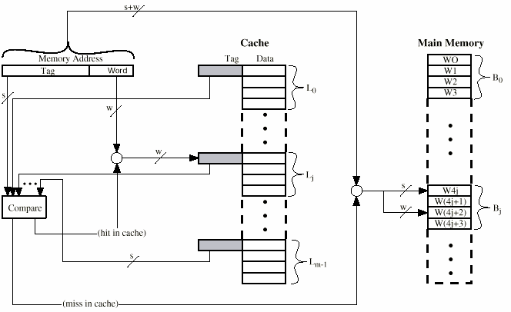
Associative Cache Organization

Slide 12
Associative Mapping Summary
Address length = (s + w) bits
• Number of addressable units = 2^{s+w} words or bytes
• Block size = line size = 2^{w} words or bytes
• Number of blocks in main memory = 2^{s+w} / 2^{w} = 2^{s}
• Number of lines in cache = undetermined
• Size of tag = s bits

Slide 13
Set Associative Mapping
Cache is divided into a number of sets
• Each set contains a number of lines
• A given block maps to any line in a given set
—e.g. Block B can be in any line of set i
• e.g. 2 lines per set
—2 way associative mapping
—A given block can be in one of 2 lines in only one set

Slide 14

Address Structure

Slide 15
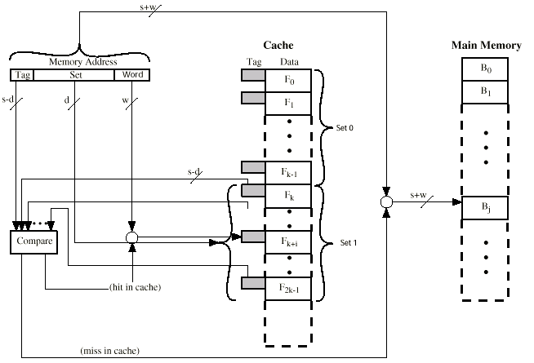
Two Way Set Associative Cache Organization

Slide 16
Set Associative Mapping Summary
Address length = (s + w) bits
• Number of addressable units = 2^{s+w} words or bytes
• Block size = line size = 2^{w} words or bytes
• Number of blocks in main memory = 2^{s}
• Number of lines in set = k
• Number of sets = v = 2^{d}
• Number of lines in cache = kv = k * 2^{d}
• Size of tag = (s – d) bits

Slide 17
Example: Set Associative Mapping
A set associative cache consists of 64 lines divided into four-line sets. Main memory contains 4K blocks of 128 words each. Show the format of memory addresses.

Slide 18
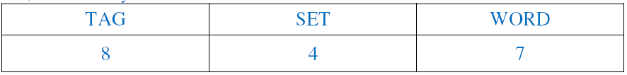
Each block contains 128 words.
– Block = 128 words.
= 2⁷ words
Therefore, 7 bits are needed to identify the word within the block.
• Cache = 64 lines / 4
– Cache is divided into 16 sets of 4 lines each (2⁴ sets).
– Therefore, 4 bits are needed to identify the set number.
• Main memory = 4K blocks of 128 words each. (2² * 2¹⁰ = 2¹² blocks)
– Therefore, 12 bits are needed to specify the block (set + tag = 12 bits).
– Tag length is 8 bits.
• Main memory = 4K blocks of 128 words each. (2² * 2¹⁰ * 2⁷ = 2¹⁹ words)
– Each word is directly addressable by 19-bit address.

Slide 19
Cache memory
Principle of locality
– Programs tend to reuse the data and instructions they have used recently.
• Types of locality
– Temporal locality
• Recently accessed items are likely to be accessed in the
near future.
– Spatial locality
• Items whose addresses are near one another tend to be
referenced close together in time.

Slide 20
Parameters of Cache memory
Cache Hit
– A referenced item is found in the cache by the processor.
• Cache Miss
– A referenced item is not present in the cache
• Hit ratio
– Ratio of number of hits to total number of references
– number of hits/(number of hits + number of Miss)
• Miss penalty
– Additional cycles required to serve the miss.

Slide 21
Cont.,
Memory access time is the best measure of the benefit of
different cache organizations
• Memory access time = hit time + miss rate × miss penalty
• Miss rate
– Fraction of cache accesses that result in a miss => number
of miss/number of accesses
• Hit time
– Time to hit in the cache
• Miss penalty
– Time to replace the block from memory (cost of a miss)

Slide 22
Cnt.,
Time required for the cache miss depends on both the latency and bandwidth
• Latency
– Time to retrieve the first word of the block
• Bandwidth
– Time to retrieve the rest of this block

Slide 23
Performance of Cache Memory System
Te = Tc + (1 - h) Tm
Where
Te: Effective memory access time in Cache memory system
Tc: Cache access time
H is hit ratio
Tm: Main memory access time
Example:
Tc = 0.4 ns,
Tm = 1.2 ns,
h = 0.85%
Te= 0.4 + (1 - 0.85) * 1.2 = 0.58 ns

Slide 24
References
Computer architecture: A quantitative approach by J. L. Hennessy & D.A. Patterson
Cache Memory Computer Organization and Architecture by William Stallings

